Slide 1
Cargo Handlers-Visualizing Port Operation
Group 9
劉俊鍵 312551159
朱昱瑋 312551132

Slide 2
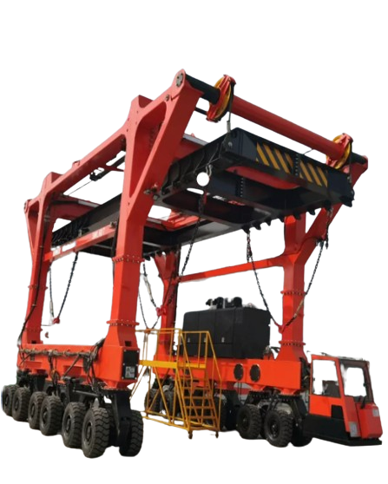
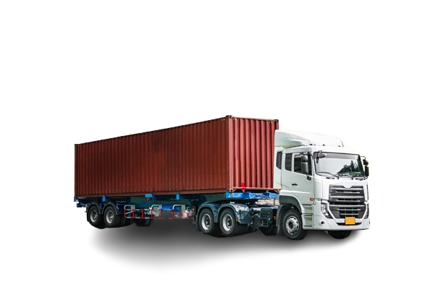
What is Port Operation?
Introduction
Port operation
In today's global trade, port operations are a critically important and intricate component. Port operation refers to the activities and processes involved in managing the departure, and handling of cargo, and goods at a port.
Important component in port operation
Gantry Transporter (吊車)
Container Truck (卡車)
Port

Slide 3
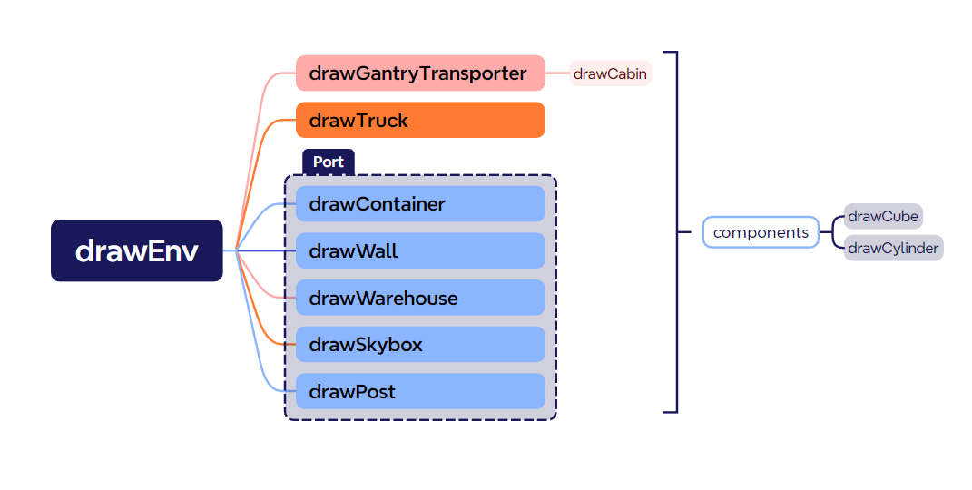
Render Overview
Introduction
Render

Slide 4
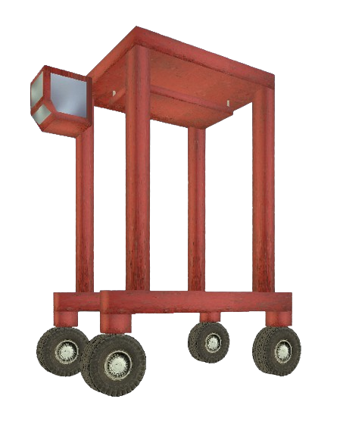
Gantry Transporter
Introduction
Render
Component
We adopted a method similar to that used in HW1.
In Gantry Transporter we render Four parts:
Cabin - customize polyhedron
Metal
Window
Spreader - element is manipulable
Board
up/down by PageUp/PageDown
catch /drop by space
Chain - length is follow with board
Wheels
Body
Cabin
Spreader
Body
Wheel

Slide 5
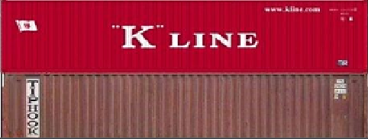
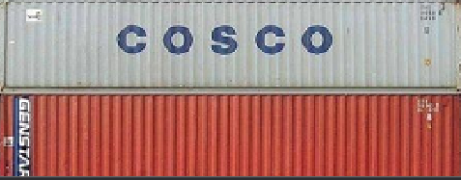
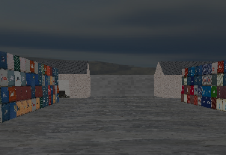
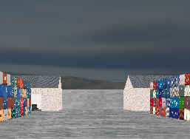
Texture and Light
Introduction
Render
Texture
Light
We render textures on the skybox and components.
We adopted a method similar to that used in HW2 and HW3.
The container texture will be randomly rendered onto one of the 12 containers’ textures.
We implement light
We adopted a method similar to that used in HW2
To simulate difference between day and night
Ambient, Diffuse, Specular, Position, Spot Direction
Light could be Turn on and off by L/l (lower case)
Notes:
Subsequently, the embedded states are utilized for correct inference recovery. Realizing states for DNNs poses two design challenges. Let me briefly explain these challenges and then propose the solution for each of them.
The first challenge involves determining where to embed states in the network, ensuring that the states and output features remain isolated and uncorrupted during inference. This is particularly challenging because embedding at specific locations may result in state loss or more severe compromises to model accuracy.
$The second challenge revolves around deciding which states to embed so that the interrupted inference process can be accurately recovered. This is not a trivial task, as the same NVM region is reused to preserve job outputs of different network layers, making it difficult to identify the latest preserved job output. Now, let's explore each challenge in more detail and solve them.

Slide 6
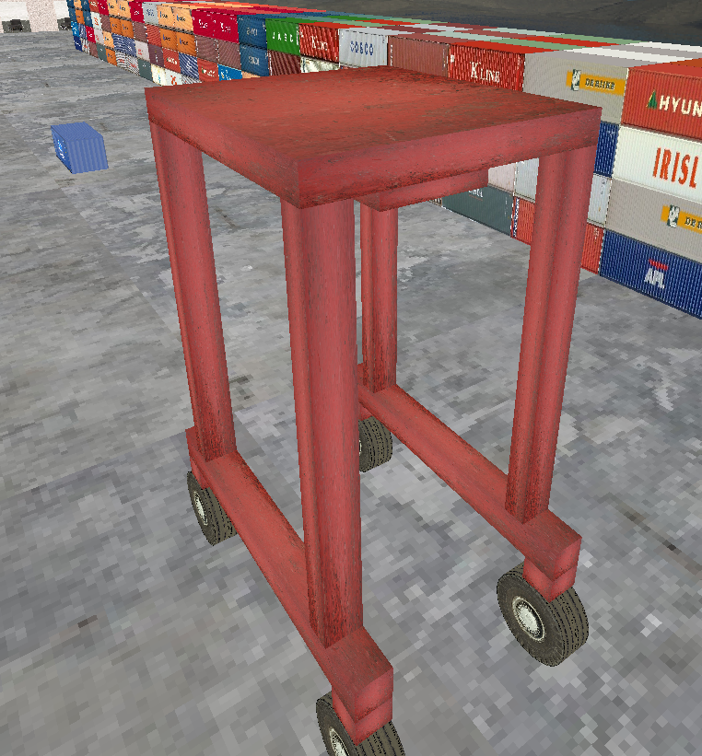
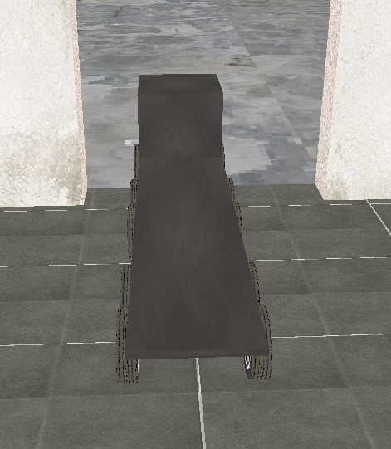
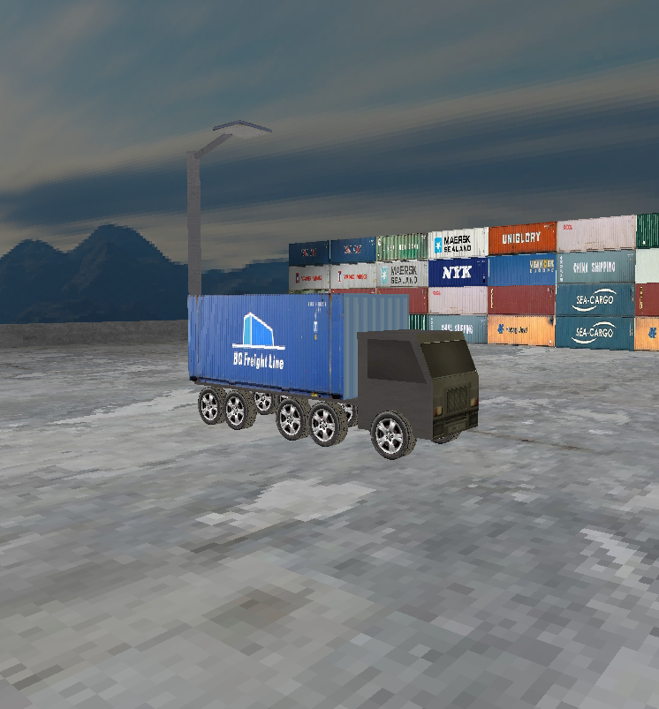
Camera Position
Introduction
Render
Texture
Light
Camera
Three different shot
We implement three different view positions: Gantry Transporter, truck and free camera.
The viewpoint could be switch by 0/1/2 perspectively.
The camera angle could be operate by mouse.

Slide 7

Port Operation Feature
Introduction
Render
Texture
Light
Camera
Port operation
How to departure and handle containers
We implement a fountain to catch/departure container by gantry transporter
Drop down spreader until reach the container
Move gantry transporter to meet truck
Drop the container on the truck and go

Slide 8
Conclusion
Introduction
Render
Texture
Light
Camera
Port operation
Conclusion
We successfully simulate basic port operation by the main three component
Environment : Visual studio 2019
Render | Gantry Transporter | catch/drop | space
 |  | up/down | PageUp/PageDown
 |  | move | w/a/s/d
 | Truck | move | w/a/s/d
 | Port | /***infrastructure***/
 | Texture | /***Above three, skybox***/
Control | Light | on/off | L/I
 | Camera | gantry/truck/free | 1/2/3
 |  | angle | mouse
Demo Time!!!

